Slide 1


Slide 2

A query is language is an interface between the user and the database.
A query language can be :
Procedural Query Language: The user has to specify what data to get and how to get that data. Relational Algebra is procedural query language.
Non Procedural Query Language: The user has to specify the what data to get without specifying how to get the data. Relational calculus is non procedural language.

Slide 3

Relational algebra is a procedural query language which specifies the operation to be performed on the relation to derived the resulting relation.
Operation applied on the relations are:
Select,project,rename,cartesian product,union, insersect,join,division,set difference ,assigment.

Slide 4
Select operation: This operation is used to retrieve the tuples the who satisfy the particular condition.
The syntax:σ<select condition>(Relation)
For eg: select those students who lives in jalandhar city:
σ_{city=‘jalandhar’} (student)
Select those student who score more then 80 marks.
σ_{marks>=80} (student)
We can use any arithmetic operator like:<,>,<=,>=,≠ etc.
We can use logical opearators (and is represented by ^,or is represented by V).

Slide 5
Project Operation: To retrieve the particular attribute from the relation we use project operation.
The syntax:π_{attribute_list} (relation)
For eg:
Show marks of all the student
π_{marks} (student)
Show name and marks of all student.
π_{marks,name}(student)

Slide 6
Rename operation: it is used to give new name to the relation.
Syntax:
ρ_{s(new} _{attribute} _{names)}(R)
ρ_{s}(R)
ρ_{(new} _{attribute} _{names)}(R)
R is the old relation name and S is the new relation name.

Slide 7
For eg: consider a relation book having attributes book_name,au_ name,Pub_year,Retail_price.
Change the relation name to temp
ρ_{temp}(book)
(ii) Change attribute name book_name as bname,au_name as aname,Pub_year as pyear and retail_price as rprice.
ρ_{(bname,aname,pyear,rprice)}(book)
(iii) Change both relation and attributes name
ρ_{temp(bname,aname,pyear,rprice)}(book)

Slide 8
Assignment Operation: when we perform some function on the relation wants to asign a name to new relation. Then assignment operation is used.
For eg:R₁ ← π_{marks}(student)

Slide 9
Join operation: This operation is use to retrieve the from the two or more relation depending upon the some condition.
For eg:
emp_sal←employee _{E.empno=s.empno}Salary
Employee table have empno,name and city and salary table have empno and salary above operation will retrieve the salary of the employee with name and city.

Slide 10

Consiser the following relation:
Course(course_id,Course_name), Assigned-to(teacher _id,course_id), teacher(teacher_id,teacher_name).
Retrieve the teacher_id of all teachers who are teaching course CSE32D
Retrieve the teacher_id,teacher-name of all thee teachers who are teaching course_id CSE32D.
Get details of teachers who are teaching the course DBMS.
Show the detail of teachers who are teaching both CSE32Dand CSe33D.

Slide 11
Consider the following relations:
Customer(c_id,c_name,c_address)
Branch(br_name,br_city,assets)
Account(c_id,act_no,br_name,balance)
Retrieve Customer name as Cust Name,Customer address as Cust Address,Balance as Balance in Account who have at least 10 lakh balance in an account.
Br_name As Branch Name,Balance of the branch where customer have balance less than 1 lakh and branch name starts with a
Customer details who have accounts in branches with asserts more than 50 crores.

Slide 12

Cartesian Product: The Cartesian product operation denoted by (X).It combines the information form two relations.
Division operation: The division operation is suited to the queries that include the pharse”for all”. It is represented by ÷.

Slide 13

Consider a following relation R:
A | B
M1 | N1
M1 | N2
M2 | N1
M3 | N1
M4 | N2
M5 | N1
M5 | N2

Slide 14
And relation S:
R÷S:
B
N1
R÷S
M1
M2
M3
M5

Slide 15
If relation S is:
R÷S:
B
N1
N2
R÷S
M1
M5

Slide 16
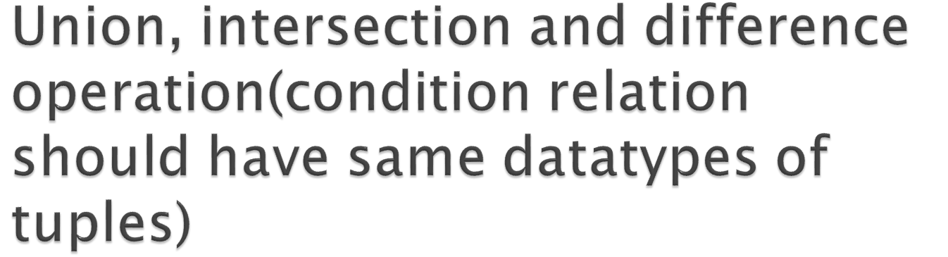
Union operation: This operation is applied two relation it retrieve those tuples which are present in both or in any of the one relation it retrieves all the tuples. Symbol:⋃.
Intersection: This operation is applied on the two relation it retrieve those tuples which exists in both the relation. Symbol:⋂.
Difference operation : This operation applied on the two relations it retrieve those tuples which are present in one relation not in other. Symbol:-

Slide 17
Consider the following relation:
Employee(Fname,Lname,Emp_id,Dob,Address,gender,salary,Dept_no)
Department(Dname,Dnumber,Mgr_id,Mgr_doj)
Depart_loc(dnumber,dloc)
Works_on(emp_id,proj_no,hours)
Project(pname,pno,ploc,dnum)
Dependent(emp_id,dep_name,gender,bdate,relationship)

Slide 18
Retrieve the name and address of all the employee who works in research department.
For every project located in ‘Delhi', list the project number, the controlling department number, and the department manager's last name, address, and birth date.
Find the names of employees who work on all the projects controlled by department number 5.
List the names of all the employees with two or more dependent.

Slide 19

Consider the following relation:
Distributror and seller having attributes as:
(reg_id,name,monthlysales,annualsales,tax)
Retrieve reg_id,monthlysales tuples which are present in seller but not in distributor of those whose monthly sales is greater than 30000.
Retrieve name,annualsales tuples which are present in both seller,distributor and as well as only in seller and distributor of those whose reg_id lies in range of 1003 to 1110.
Retreive reg_id,tax tuples which are common in both seller and distributor of those whose name starts with s and ends with a.

Slide 20

Generalize Projection: we can perform various arithmetic operations on the columns and retrieve the data and give those columns a new name by rename operation
For eg: Retrieve the employee_id,net_salary of the employee which is computed by deducting the deductions from the basic salary of the employee.
ρ _{(Employee_id,net_salary)} (π employee_id,basic_sal-dedecution (employee))

Slide 21
Aggregate function and grouping:
We can use this operation when we have group certain attributes and apply operations such as sum,count,average,min and max we use this operation.
<grouping attribute>ℨ<function list>
For eg: retrieve the number of employees working in various department and also find the average salary of the department.
Dno ℨ _{COUNTemp_id,AVERAGE} _{salary} (Employee).

Slide 22
Consider a following relation:
Customer(custno,cname,city)
Order(orderno,odate,custno,ord_amt)
Order_item(orderno,itemno,qty)
Item(itmeno,unit_price)
Shipment(orderno,warehouseno,ship_date)
Warehouse(warehouseno,city)
1.List the orderno and ship_date for all the orders shipped from warehouseno W2.

Slide 23
List the warehouse information from which the customer name “amit” has supplied his orders.produce a listing: orderno,warehouseno.
Produce a listing cname,no_of_orders,Avg_order_amt for the customer.
List the orderno for the orders that were shipped from all warehouses that the company has in new york.

